Slide 1


Santosh Kumar Kar,
skkar.2k2@gmail.com

Slide 2
CHAPTER – 6
Service Discovery
Santosh Kumar Kar,
skkar.2k2@gmail.com

Slide 3
Why Service Discovery
In a micro-service architecture, there will be multiple micro-services running in different servers.
Microservices may communicate to each other. They use the service through the URL. But there could be the problem
The URI of the service may change at anytime because of changes of
Data center they are located in
The region they are located in
The no. of instances that are available
Other changes
Very challenging to configure

Slide 4
Why Service Discovery (contd.)
Service Discovery track records of component of services such as
The current URL of the application
How many instances are available/running
The status whether they are up/do
The healthy or not
Service Discovery provides a single 'lookup' service
Clients register themselves, discover other registrants

Slide 5
What is Eureka
Eureka is a REST (Representational State Transfer) based service that is primarily used in the AWS cloud for locating services for the purpose of load balancing and failover of middle-tier servers.
We call this service, the Eureka Server
https://github.com/Netflix/eureka/wiki

Slide 6
Service Discovery Frameworks
Netfilx Eureka (the most popular)
Apache Zookeeper
Consul
Etdc
SmartStack

Slide 7
Making Eureka Server
Add starter dependency - spring-cloud-starter-netflix-eureka-server
Use annotation - @EnableEurekaServer
In application.properties
Use the commonly used port (8761)
eureka.client.register-with-eureka=false
eureka.client.fetch-registry=false
Can run multiple instances of Eureka Server for high availability

Slide 8
Eureka Client/Server Communication:
Talk to Eureka Server: First, Eureka client talks to Eureka server when started. It connects to first the same zone where the client is. In case the server is down, it will try to connect to other zone.
Register: Next Eureka client/microservices shares the instances information with Eureka server and register itself with the {service-id } (spring.application.name).
HeartBeat: After registering is successful after every 30 seconds Eureka client sends heartbeat to Eureka server to renew its leases. So if till 90 seconds if Eureka server not getting any heartbeat from Eureka client it unregisters the Eureka client instance from Service registry and sends the updated registry to all peers and Eureka clients.

Slide 9
Eureka Client/Server Communication(Contd…)
Fetching Service Registry : Eureka clients fetch service registry from Eureka server so it can discover other service and communicates with them. After every 30 seconds this service registry information getting updated by receiving delta updates from Eureka server, Please note that Eureka server also caches the delta updates still 3 minutes so Eureka client can receive same delta instances multiple times. After receiving delta updates it again tries to compare its local registry with server registry to check delta is applied successfully or not if there are any mismatches it pulls all the registry again.
Unregister: when the Client instances are going to shut down it sends a cancel signal to Eureka Server so Eureka server unregisters it from its registry.
Synchronization : As Eureka server manages cache and also clients, it may takes some time to get reflected the original status to peers. It’s called Time lag.

Slide 10
Eureka Server - Dependencies
<dependency>
<groupId>org.springframework.cloud</groupId>
<artifactId>
spring-cloud-starter-netflix-eureka-server
</artifactId>
</dependency>

Slide 11
Eureka Server – Annotation for Eureka Server
@SpringBootApplication
@EnableEurekaServer
public class MyEurekaServerApplication {
public static void main(String[] args) {
SpringApplication.run(MyEurekaServerApplication.class, args);
}
}

Slide 12
Eureka Server – Properties
server.port=8761
eureka.instance.status-page-url=${management.contextPath}/info
eureka.instance.home-page-url-path=${management.contextPath}/health
#eureka.instance.hostname=localhost
# This also can be client because it talks to other Eureka server
eureka.client.register-with-eureka=false
eureka.client.fetch-registry=false
eureka.client.service-url.zone1=http://localhost:8761/
eureka.client.service-url.zone2=http://127.0.0.1:8761/
eureka.client.availability-zones.region1=zone1, zone2
spring.profiles.active: zone1

Slide 13
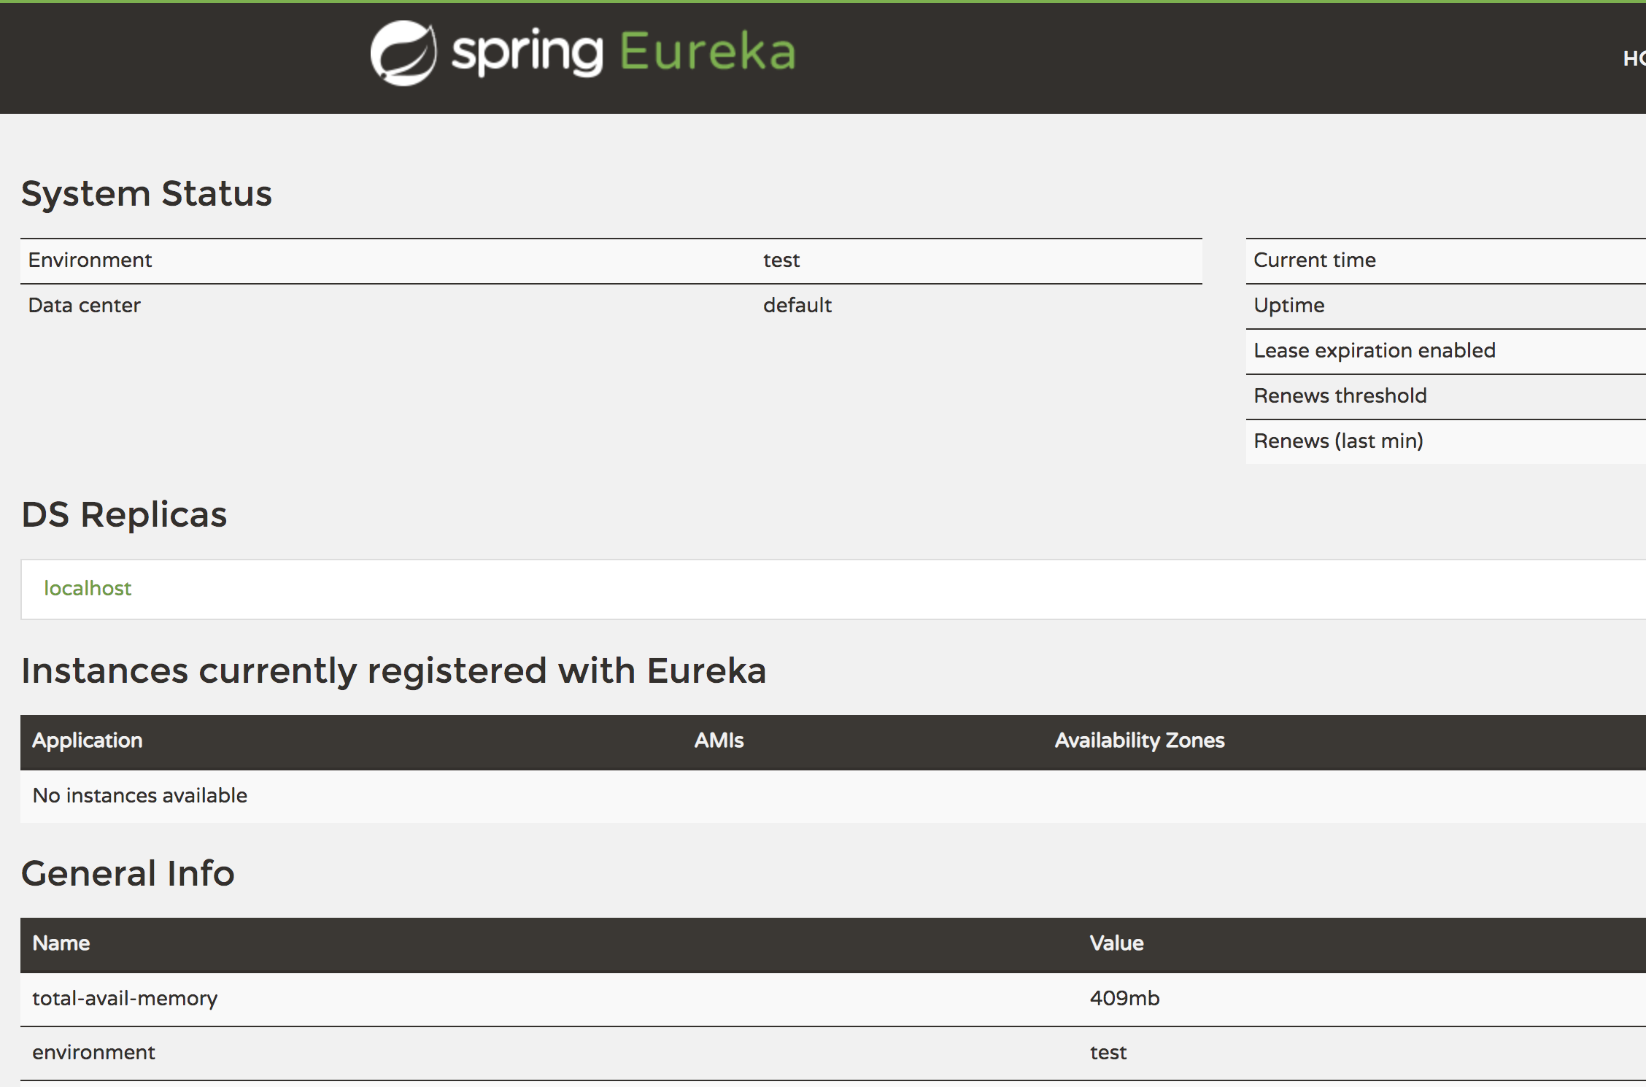
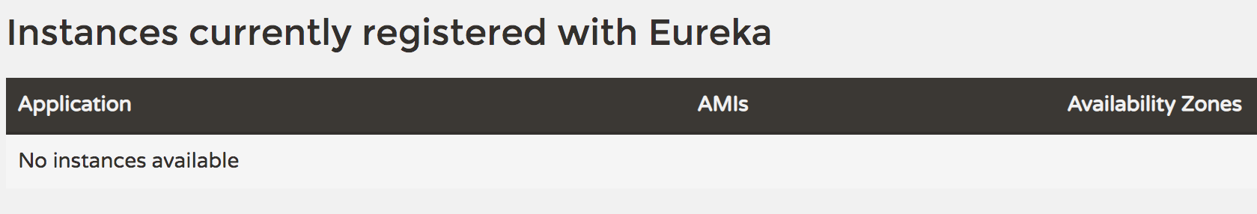
Access the URL
http://localhost:8761
You should be able to access the URL. However you won’t be able to see any client being registered with this server.

Slide 14
Making Eureka Client
Add starter dependency - spring-cloud-starter-netflix-eureka-client
With Other dependencies such as:
spring-boot-starter-web
spring-boot-starter-actuator
Use annotation - @EnableEurekaClient
In application.properties
spring.application.name=<optional: your app name so it will be shown in eureka>
eureka.client.service-url.defaultZone=http://localhost:8761/eureka,http://localhost:8762/eureka

Slide 15
1. Add starter dependency
<dependency>
<groupId>org.springframework.cloud</groupId>
<artifactId>
spring-cloud-starter-netflix-eureka-client
</artifactId>
</dependency>
<dependency>
<groupId>org.springframework.boot</groupId>
<artifactId>spring-boot-starter-web</artifactId>
</dependency>
<dependency>
<groupId>org.springframework.boot</groupId>
<artifactId>spring-boot-starter-actuator</artifactId>
</dependency>

Slide 16
2. Use annotation
@EnableEurekaClient
@SpringBootApplication
public class MyEurekaClientApplication {
public static void main(String[] args) {
SpringApplication.run(MyEurekaClientApplication.class, args);
}
}

Slide 17
3. application.properties
spring.application.name=First Eureka Client
eureka.client.service-url.defaultZone=http://localhost:8761/eureka
Client can be registered in multiple servers. In that case, you can use multiple URLs
eureka.client.service-url.defaultZone=http://localhost:8761/eureka,http://localhost:8762/eureka

Slide 18
Now run the client
Now you run the web client. After running, you should see the app registered with the Eureka server
All the clients that registered with Eureka Server will be listed in the UI

Slide 19
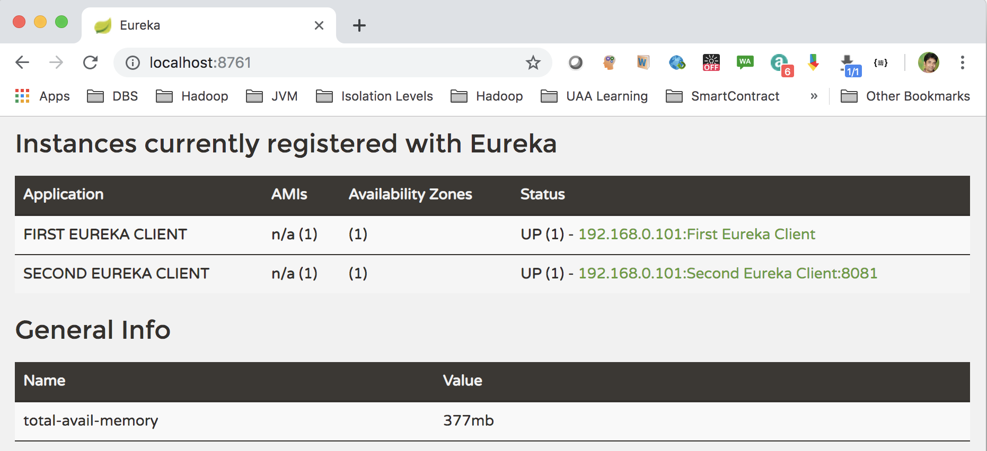
Application Ids

Slide 20
Accessing URI running in different service
In Microservice architecture, there is multiple Microservice applications running
One service may consume another service by accessing the URI, e.g. exchange service can be used in other micro services.
URIs can be accessed through the api – RestTemplate e.g.
RestTemplate restTemplate = new RestTemplate();
String host = "http://localhost:8080";
String mapping = "/message";
String uri = host+mapping;
String msg = restTemplate.getForObject(uri, String.class).toString();

Slide 21
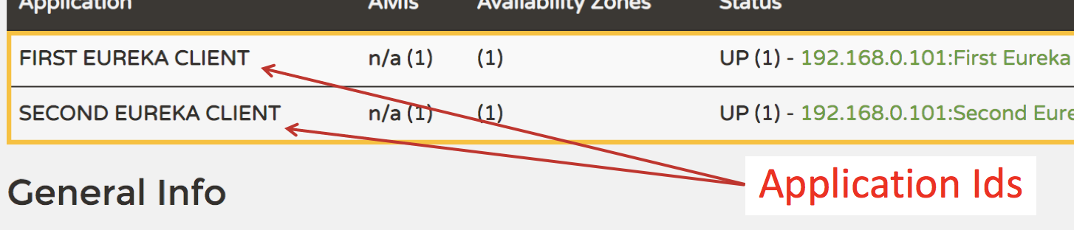
Accessing URI in Service Discovery environment
As we saw the URI can be changed at anytime and also there are other benefits of using the Servie Discovery, we will not access the URL directly. So we will access the service using the Application Id which are being regisered in the Eureka service.

Slide 22
Accessing URI in Service Discovery environment (Contd.)
@Autowired
private DiscoveryClient discoveryClient;
@Autowired
private RestTemplate restTemplate;
@GetMapping("/fromOtherClientWithEureka")
public String readFromOtherClient() {
List<ServiceInstance> instances = discoveryClient.getInstances(
"FIRST EUREKA CLIENT");
String host = instances.get(0).getUri().toString();
String mapping = "/message";
String uri = host+mapping;
String msg = restTemplate.getForObject(uri, String.class).toString();
return msg;
}

Slide 23

Questions
Send to skkar.2k2@gmail.com

